Slide 1
Data analytics
Market overview, applications, and benefits

Slide 2

Table of content
1. | Introduction
2. | Data Analytics Process
3. | Types of Data Analytics
4. | Business applications of Data Analytics
5. | Benefits of Data Analytics
6. | Use Cases of Data Analytics by industry
7. | Case studies

Slide 3
Introduction
Data analytics is the process of analyzing data in order to answer questions, extract relevant insights, and identify trends. It can help optimize processes and increase efficiency. Companies leverage data analytics in a variety of areas, including budgeting and forecasting, risk management, marketing and sales, and product development.
In the last two years, companies have been forced to adapt quickly to major disruptions and evolving customer needs. These developments, along with increased competition and digitalization, have highlighted the importance of data analytics to make better decisions.

Slide 4
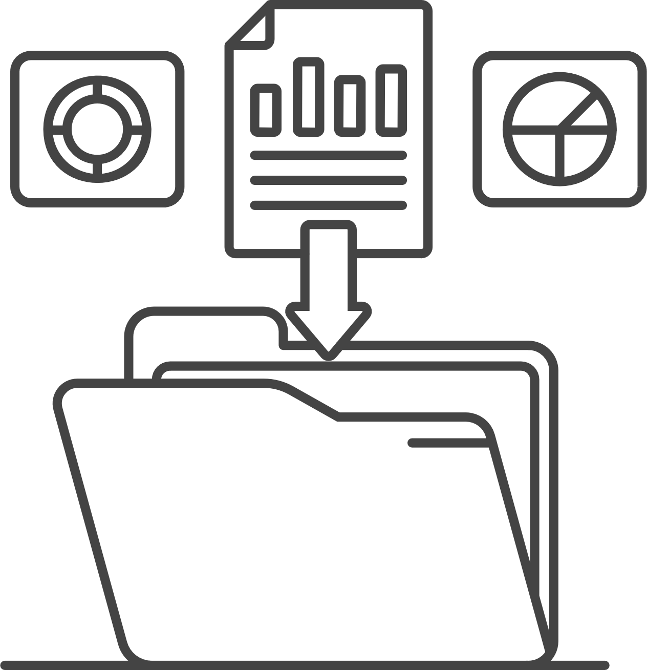
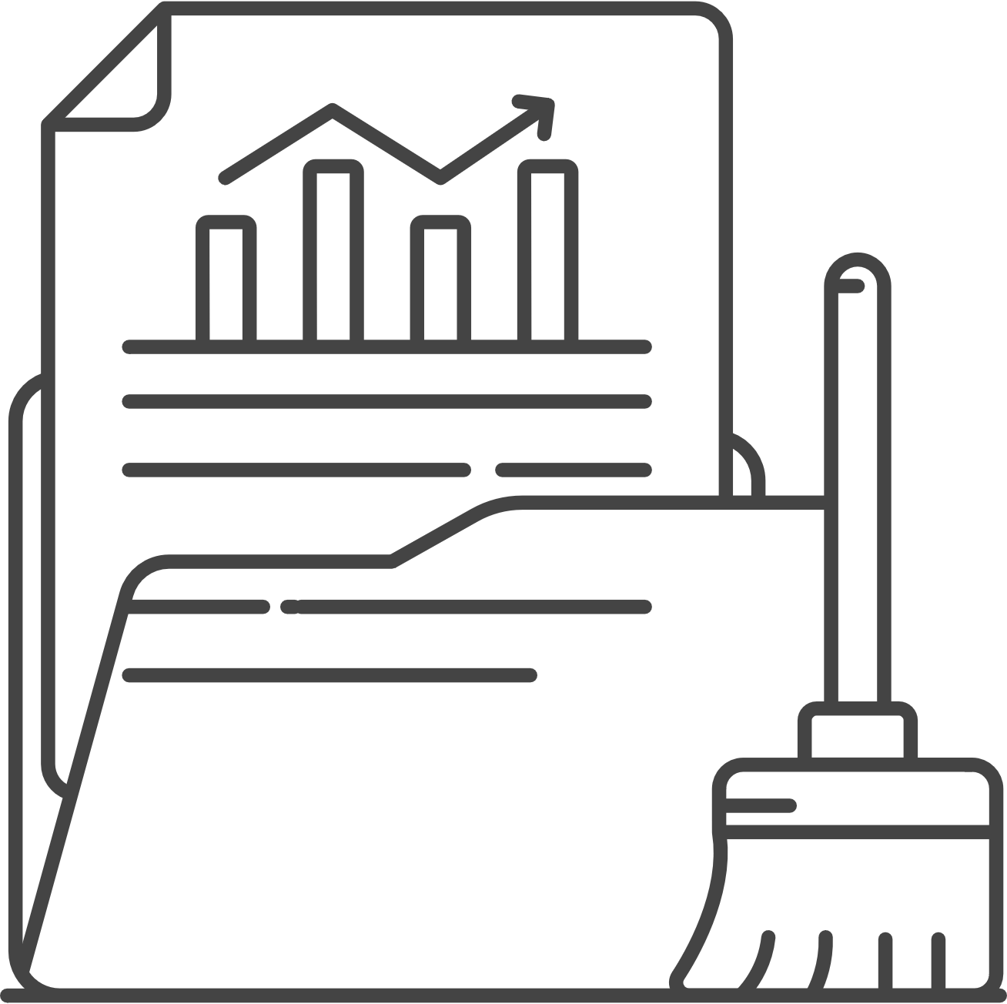

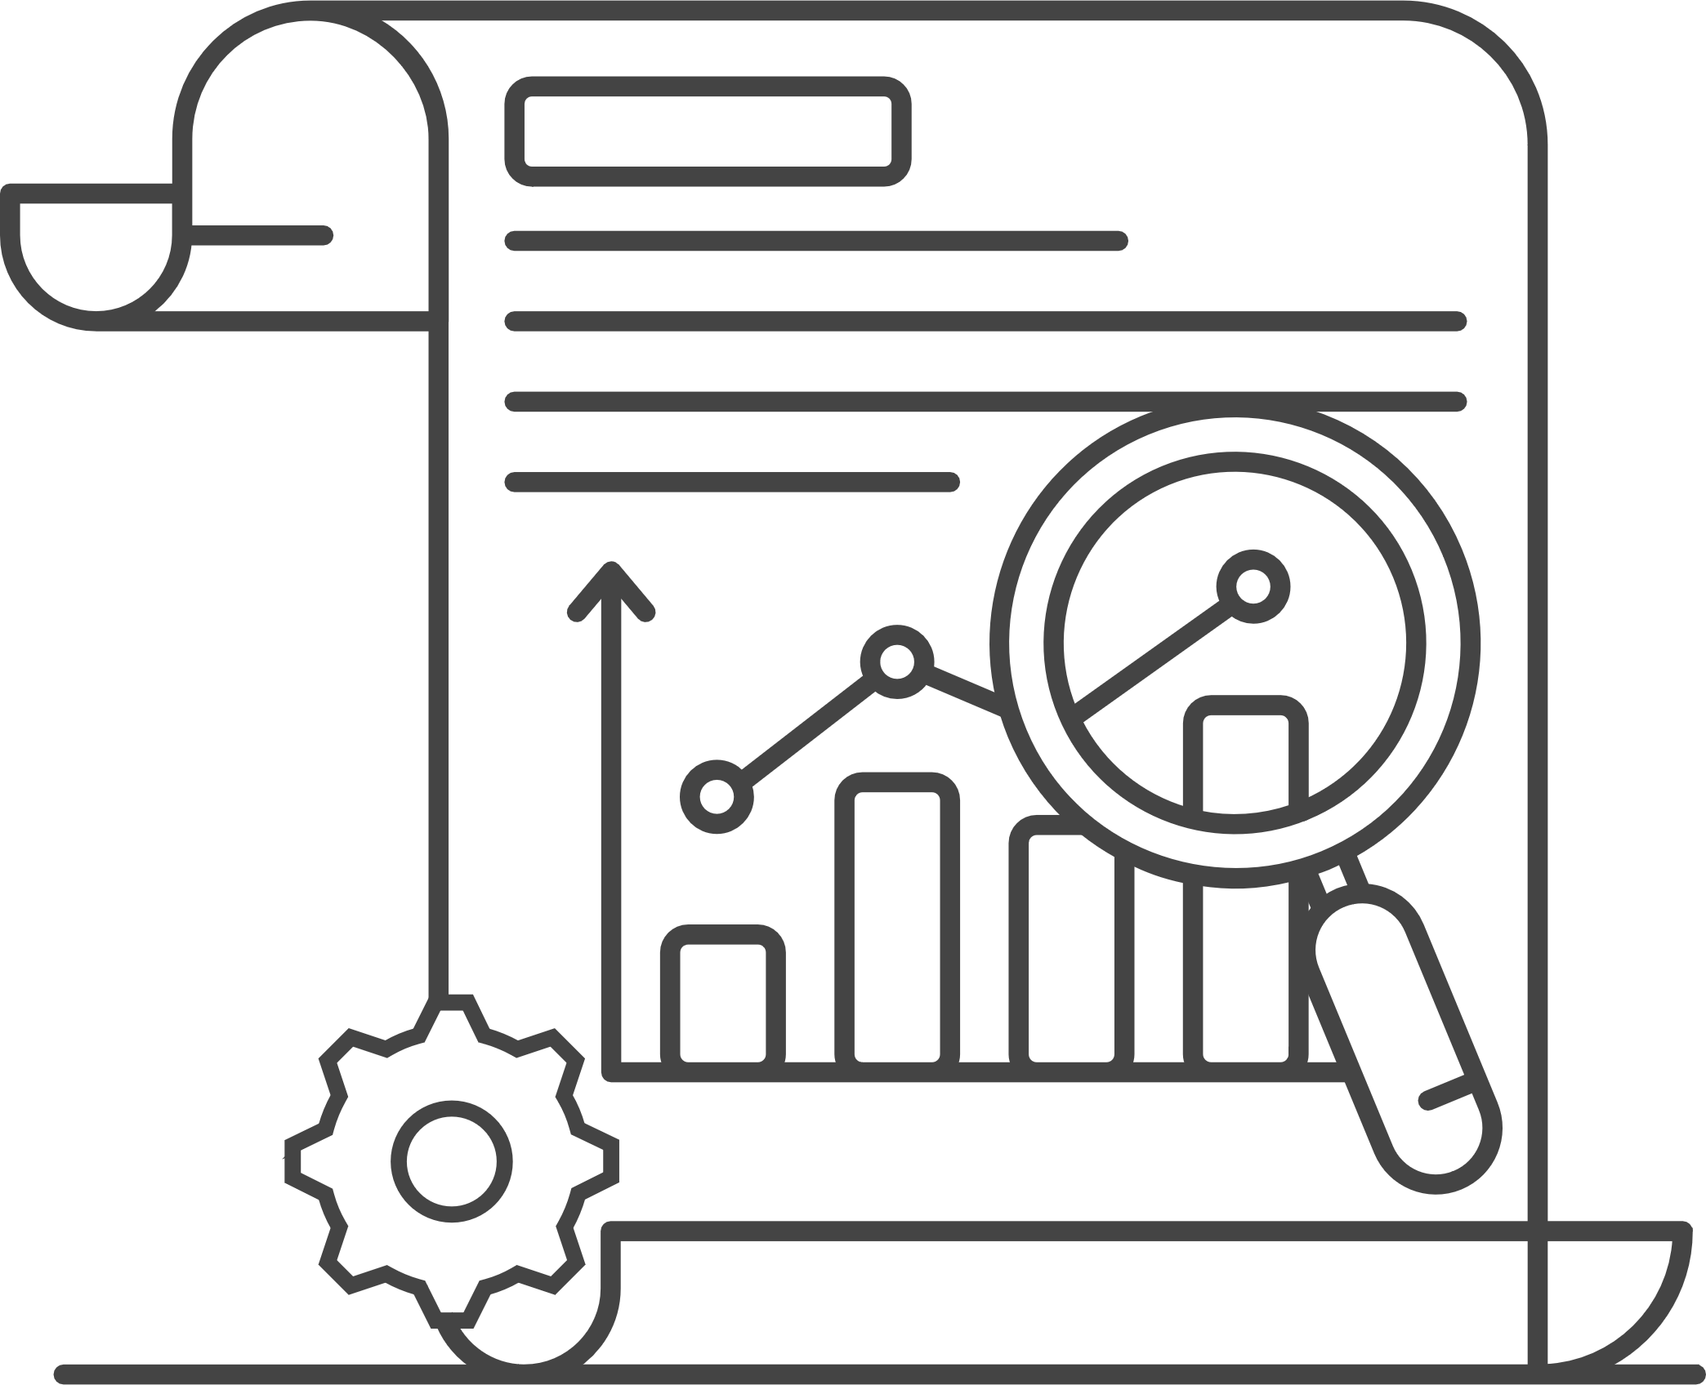
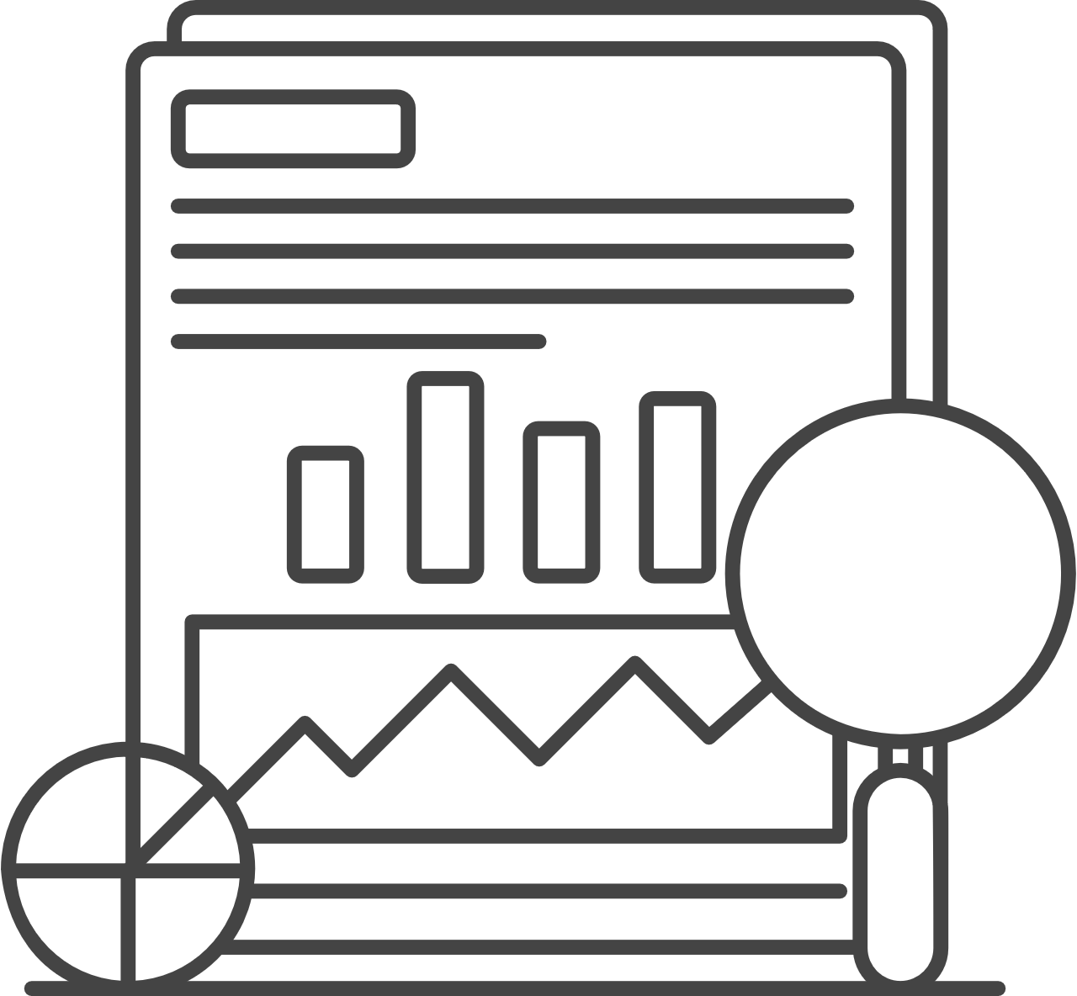
The data analytics process involves identifying the business objectives, gathering the data, processing it, evaluating the results, and creating the final report
Determining the business objectives
Assessing the situation (resource availability, project requirements, assessing risks)
Determining data mining goals and producing the project plan
Business understanding
Collecting initial data and loading it in the analysis tool
Describing data (data format, number of records, field identities)
Exploring data and verifying its quality
Data understanding
Data munging prepares the final data set(s) for modeling. It includes selecting data, cleaning it (correcting, imputing, or removing erroneous values), constructing data, integrating it (by combining the data from multiple sources), and formatting it
Data preparation
Selecting modeling techniques
Generating a test design (splitting the data into training, test, and validation sets)
Building and assessing the model
Modeling
Evaluating results
Reviewing completed work (summarizing findings and correcting anything if needed)
Determining the next steps (based on the previous tasks)
Evaluation
Plan deployment
Plan monitoring and maintenance (avoid issues during the operational phase of the model)
Producing the final report (including a final presentation of data mining results)
Deployment
Sources: Data Science Process Alliance “What is CRISP DM? (2022)”

Slide 5


Businesses leverage data analytics for various purposes
Anomaly detection
Spotting anomalies in data sets for fraud detection and cybersecurity
Classification & categorization
Sorting through large amounts of data and categorizing or classifying it based on learned characteristics, which is especially useful with unstructured data
Pattern recognition
Identifying customer purchasing behavior patterns helps develop relevant marketing strategies and ensure supply chain reliability
Sentiment & behavioral analysis
Categorizing customer sentiment and behavior and tracking how they change over time
Predictive modeling
Applying machine learning and other algorithmic approaches to large data sets to predict market trends and customer behavior
Conversational systems
Training systems on large amounts of texts to derive conversational patterns from the data
Recommendation engines
Building detailed profiles of individual customers and tailoring products and services to their specific needs
Autonomous systems
Making the development of autonomous vehicles, AI-powered robotics, and other intelligent machines more feasible
Sources: Press search

Slide 6



Data Analytics provides valuable insights that improve decision making and overall business efficiency
Improving the customer experience
Tailoring customer experience, building stronger connection, and enhancing overall experience
Minimizing financial loss
Guiding business decisions and minimizing financial losses
Data analytics benefits
Enhancing security
Diagnosing the causes of past data breaches by processing and visualizing relevant data
Saving time
Spending less time on manual tasks and focusing more on value-added work
Streamlining operations
Improving operational efficiency and predicting future problems within a company
Improving market predictions
Identifying emerging market trends by collecting and analyzing data on a larger scale
Sources: Press search

Slide 7




Various approaches to data analytics include looking at what happened, why it happened, what is going to happen, or what should be done next
Descriptive
Diagnostic
This type of data analytics helps compare past results, identify anomalies, and distinguish strengths and weaknesses
Diagnostic data analytics is the process of examining data to understand cause and effect or why something happened
Predictive
Prescriptive
Predictive data analytics involves using current or historical data to predict future actions
This type of data analytics examines results from other analytics and gives guidance on how to reach a specific answer
Sources: Oracle, Press search

Slide 8




Healthcare, transportation, financial services, and energy are some of the main sectors leveraging data analytics
In healthcare, data gathered from patients regarding their experiences with medical practitioners can be analyzed to reveal areas for improvement. Data analytics can predict trends in the spread of illness, allowing hospitals to adequately prepare. It can also accelerate drug discovery and development. For example, AstraZeneca used data and machine learning to build a recommendation engine that empowers scientists to more easily uncover new novel drugs quicker, cheaper, and more effectively.
In transportation, the daily collection of data helps the industry provide better management for its users. Using data analytics, the organizations can detect routes with traffic, closures, or development and construction and suggest alternate routes, thereby providing better services.
In the energy sector, companies are using predictive modeling to improve equipment reliability and reduce the cost of unpredictable reactive and downtime maintenance. For oil and gas companies, analytics can help Oil & Gas firms are using data solutions to drive refinery, distribution processes, and real-time adjustments to market demands.
In financial services, data analytics can help enhance risk assessment and better detection of fraud. In banking, analytics can be used to assess the risk profiles of credit applicants in detail and improve credit assessments. In the insurance industry, data analytics can be used to prioritize insurance claims, resulting in faster settlements. Analytics can also help mitigate claims fraud and make better informed underwriting decisions. For example, AXA UK uses data analytics to improve its claims process and speed up decision making. During a pilot test, the company reported around a 25% reduction in claims being re-routed and substantial cost reductions.
Sources: Press search

Slide 9



Case study: A self-service solution to improve Enel Green Power’s failures detection, and reduce downtime
Enel Green Power is a company dedicated to the development and operation of renewables around the world
EGP’s management has found itself spending too much on maintenance needs across their facilities, with no advance notice of failures
Situation
Enel is the 2nd largest utility in the world with over 42 GW or energy under management
The challenge was finding the best way to monitor and perform maintenance on their geothermal plants located 1700 feet underground at 310°F
Challenge
Implementing a self-service solution that monitors electrical and operating data to detect signature anomalies, and automatically reports those back
Auto-generated reports describe the anomalies, summarize the data, and allow users to immediately take corrective actions in less than 4 weeks
Solution
A reduction of downtime of 90%
Increased supply chain management, and internal communication
54 days advance notice of failures
Streamlined the detection-to-repair process
Results
Sources: NarrativeWave “How Enel Green Power Saved Time and Operational Costs with NarrativeWave”, “Infographic: Enel and NarrativeWave - Electrical Submersible Pumps”

Slide 10

Case study : Eliminating shadow IT by facilitating self-service analytics
Rabobank is one of the largest financial services institutions in the Netherlands
The bank needed to access to high quality, accurate and timely customer data
Situation
Providing these insights required sophisticated and timely data analytics at scale
The bank lacked the ability to stream and analyze data in real time
Challenge
Using a Cloudera platform, the bank was able to create a new data lake that would allow its employees to run faster queries across a single SQL interface including both historical and real-time data
Solution
Rabobank can now detect warning signals in very early stages of where clients may go in default
Managers can access an in-depth overview of customer data
Results
Sources: Cloudera “Using Data and Analytics To Enhance Customer Experience In Financial Services”

Slide 11

Case study: Overcoming the challenge of direct data collection in ORs and ICUs with unstable internet connections
Cardinal Health is a multinational healthcare services company
After a series of acquisitions, the company had a fragmented set of systems that made managing and accessing data complicated
Situation
The company’s antiquated systems weren’t sufficient for modern self-service analytics
The company needed to forecast six months in advance to make sound business decisions, but business analysts across different business lines didn’t have easy access to data for analytics and reporting
Challenge
The company chose to leverage Google BigQuery and AtScale’s Semantic Layer, which allows business users to access data using business intelligence tools like Excel and Tableau
By implementing a semantic layer, the company is now able to more easily share this disparate data to generate better overall business insights
Solution
This has enabled the company to eliminate the shadow IT applications that business analysts had relied on previously
AtScale made it possible to reliably access the same data from different BI tools for more accurate reporting
Cardinal Health has been able to scale the rollout to over 200 users and expects to have over 1,000 business users leveraging self-service analytics
Results
Sources: AtScale “Cardinal Health: Driving Advances in Healthcare Through Self Service Data Analytics”

